Slide 1

Parallel Universe

Slide 2
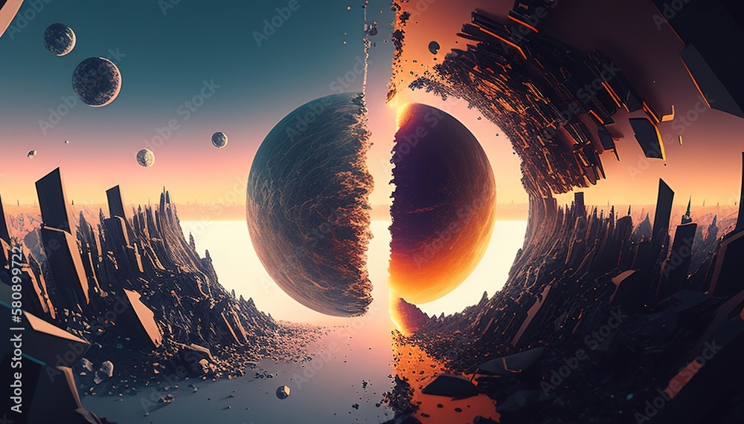
Parallel universe
A parallel universe is a separate world or dimension where:
1.The laws of physics might differ,
2.History might have taken another path,
3.And there might even be another YOU living a different life
It is like reality has many branches and we live in just one of them

Slide 3

Mystery man from taured :
July 1954,
A man arrived at Tokyo ‘s Haneda Airport on a routine flight from
Europe . Everything seemed normal until the officers checked the passport . The passport looked authentic , but it
Listed the man’s country as TAURED . The immigration officers were confused . They have never heard of any country
Named TAURED. The traveller insisted that the country was a real nation located between SPAIN and FRANCE and e
Existed for more than 1000 years .When the officers showed him the map , he became angry because,in his reality
The area was labelled as ANDORRA instead of Taured.
Suspicious ,the authorities checked his passport ,driver’s license and bank records .Everything seemed genuine
-yet no record of Taured existed anywhere. They placed him in a secured hotel for further inverstigations.
The next morning when the police checked, he along with his belongings had vanished.
HE WAS NEVER SEEN AGAIN.

Slide 4
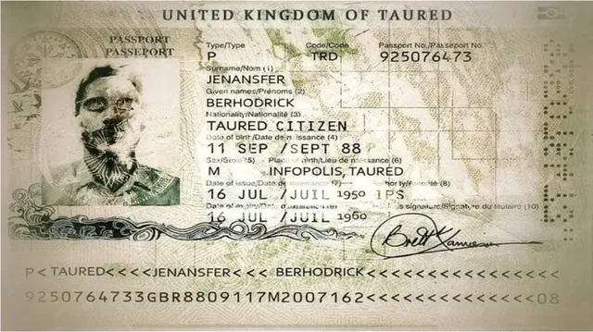

Slide 5
THEORIES :
1.Parallel Universe theory- the man accidently slipped into a parallel dimension where “Andorra “ doesn’t
Exist and “Taured” does.
2.Time travellar theory-could been have from different timeline
3.Hoax theury- the story was invented or distorted over time –possibly mistaken for real event
4.Mistaken identity theory-may be exaggerated from a passport forgery
It was appeared in various mystery novels and magazines in 1960s and 1970s but no official records
Confirmed it.

Slide 6
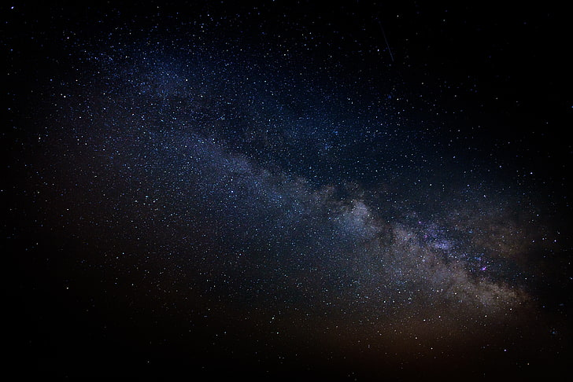
MANDELA EFFECT :
The MANDELA EFFECT happens when a large group of people share same false memory about an event , name ,
Or a detail from the past.
The term was coined by FIONA BROOME in 2009. She and many others rememberd NELSON MANDELA
Dying in prison in 1980s and recalled seeing news coverage and mourning events.
But in reality ,Nelson Mandela was realeased from prison in 1990s and became South Africa’s president in 1994
He passed away in 2013 , decades later.

Slide 7
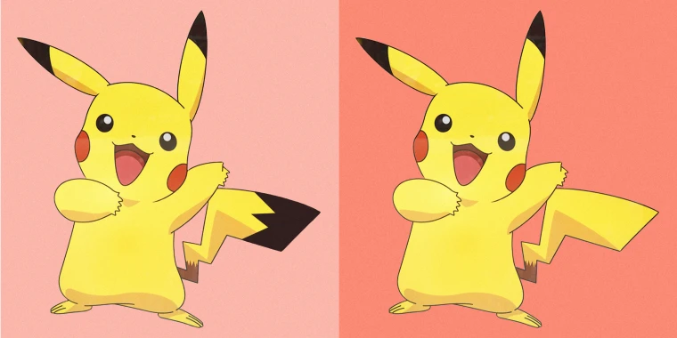

Slide 8
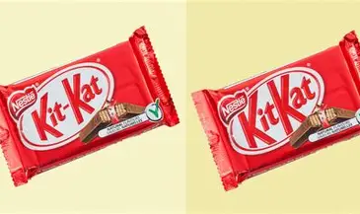

Slide 9
THEORIES:
1.Pschological explanation- Our memoru fills gaps and social sharing strengthens false versions
2.Parallel universe theory- like TAURED case
3.Time travel or Simulation theory- others suggests thst someone may altered the timeline
,creating small “glitches” in history
4.Social influence and Internet spread-sharing of false memory,many others adopting leads to
Reinforcing of illusion

Slide 10

DEJAVU :
French term –”already seen”
The strange feeling when you experience something and suddenly feel like you’ve lived that moment before
THEORIES:
1.Memory mix-up theory-brain creates a new memory before you consciously register it making it feel
Familiar
2.Dual process theory-info through 2 paths and if 1 lags ,the delayed signal feels repeated
3.Dream –may have dreamed before and when it happens ,it feels familiar
4.Parallel universe theory-could be a glimpse into a parallel universe –where another version of you has already
Lived that moment
This Photo by Unknown Author is licensed under CC BY-NC

Slide 11
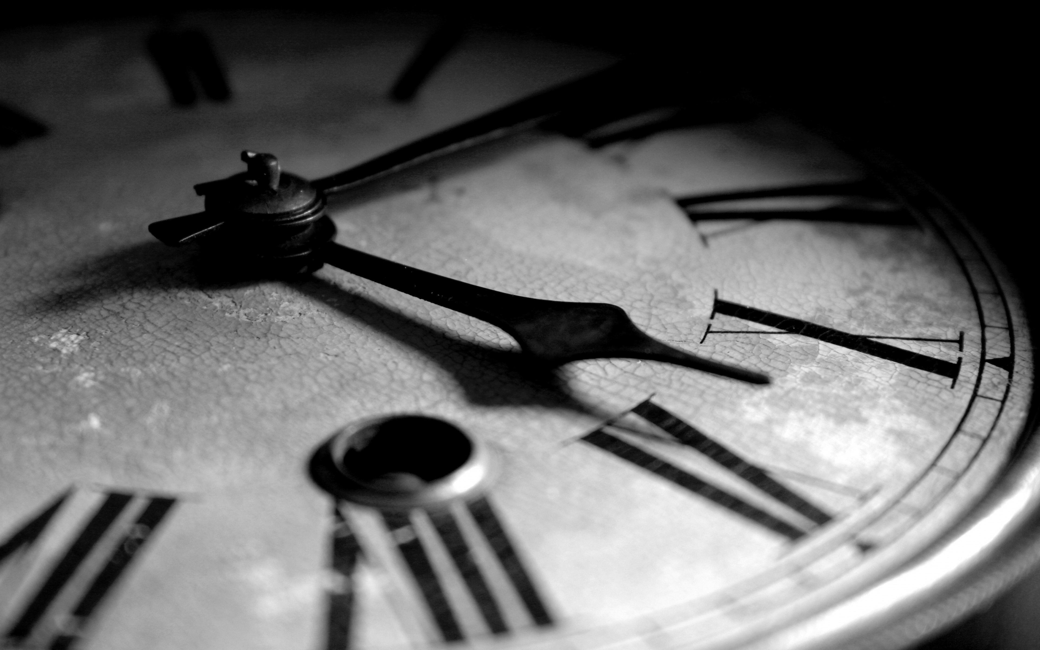
THANK YOU
This Photo by Unknown Author is licensed under CC BY-NC-ND

